Slide 1

WEAT Analysis of Human and Language Model Biases in Romanian
A study comparing human judgments with the knowledge of language models trained on human-written texts
Topliceanu Maria-Adina Chera Gabriel-Alexandru​

Slide 2
Why Study Bias in Romanian?
Most WEAT and CA-WEAT research focuses on English, Spanish, or Chinese.
Romanian is rarely included in multilingual bias studies.
Language models trained on human texts may reproduce or amplify cultural biases.
Goal: measure and compare biases in humans vs. AI models in Romanian.

Slide 3
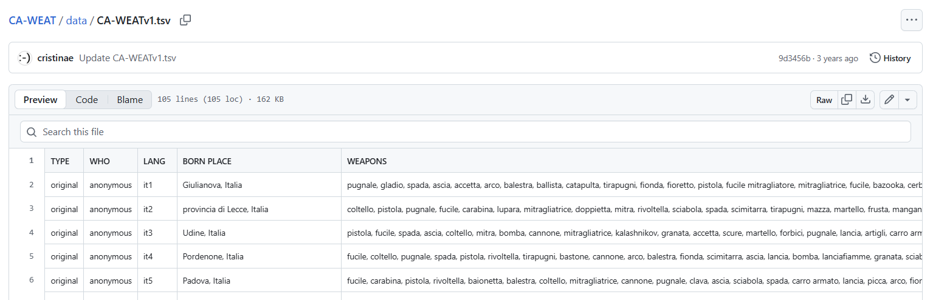
Data
Word lists from Github → translated into Romanian.

Slide 4
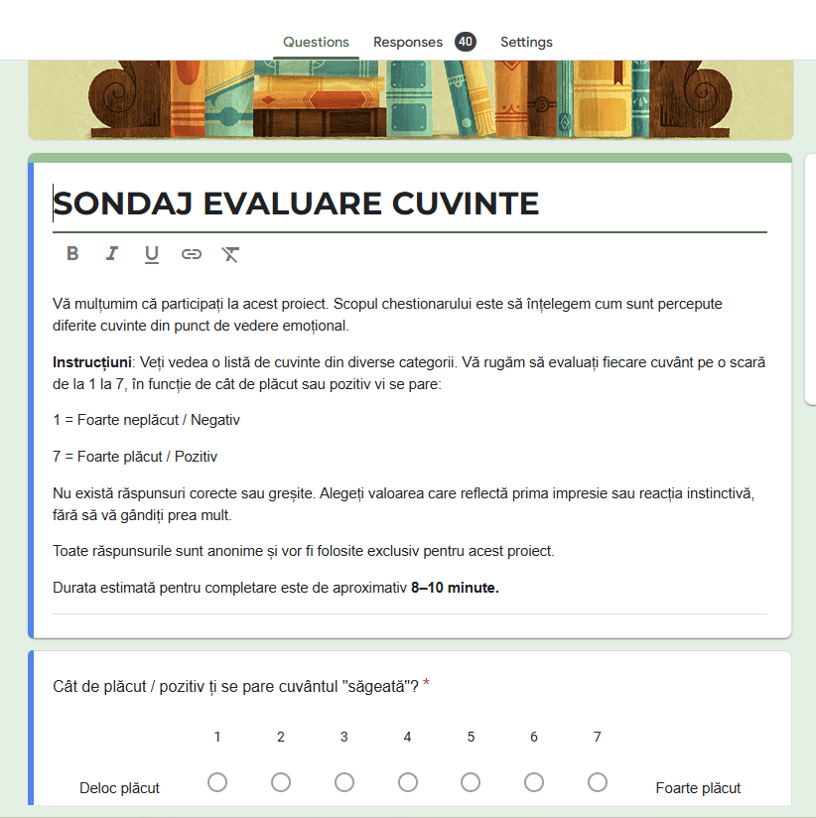
Human survey: 40 Romanian participants, diverse age.

Slide 5
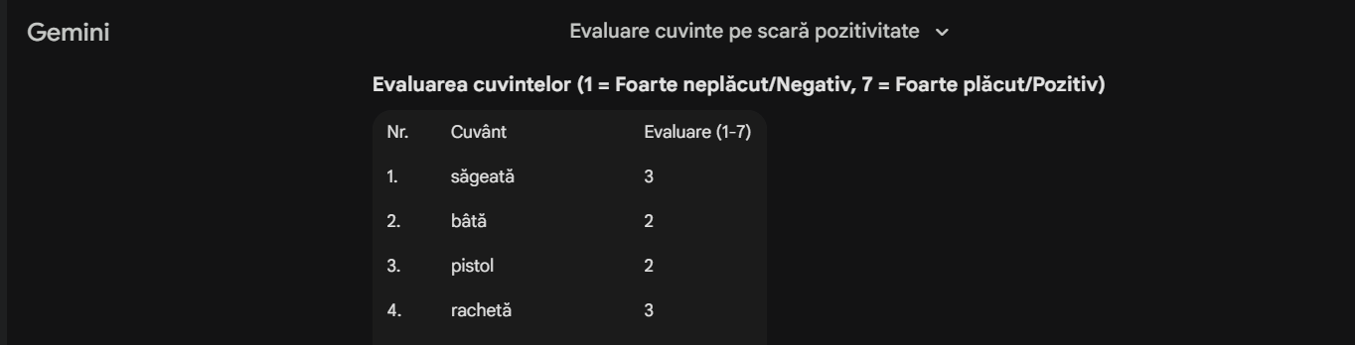
AI model evaluation: ChatGPT, Gemini Pro, NotebookLM, Meta AI, DeepSeek, Perplexity AI.

Slide 6
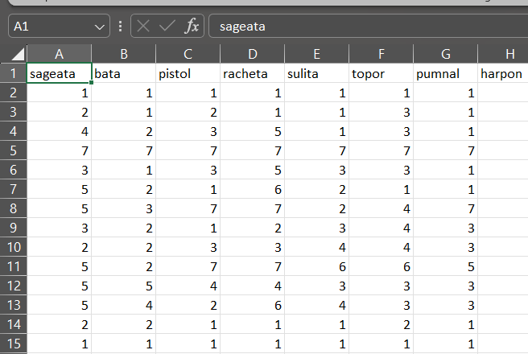
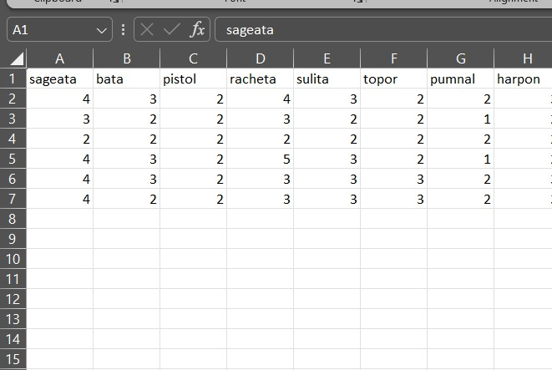
Dataset
All data is collected and stored in CSV files, easier to be accessed in python.

Slide 7
Approach
Retrieving the data from GitHub.
Gathering data from humans and Language Models.
Clean and align datasets (human + Language Model).
Next step: apply WEAT on the embeddings and interpreting the resulting bias score.

Slide 8
Measuring Bias with WEAT
Comparing target words (e.g., bomba/lalea) with attribute words (e.g., negativ/pozitiv).
Cosine similarity between numerical ratings.
Output: effect size / bias score → shows direction and strength of bias.

Slide 9
What We Learned
Learned how to design surveys, process data, and understand WEAT scores.
Learned how LMs reflect biases from human-written texts.
Reference for future research: explore how biases vary across dialects of Romanian and investigating how different training data might influence the presence of biases.

Slide 10
Repository
https://github.com/mariaxadina/WEAT-Analysis-of-Human-and-Language-Model-Biases-in-Romanian

Slide 11
References
Corpus del Español REAL. Available at: https://cereal-es.github.io/CEREAL/#data
España-Bonet, C., & Barrón-Cedeño, A. (2022).
The (Undesired) Attenuation of Human Biases by Multilinguality.
Available at: https://aclanthology.org/2022.emnlp-main.133/
Barrón-Cedeño, A., & España-Bonet, C. (2024).
Elote, Choclo and Mazorca: on the Varieties of Spanish.
Available at: https://aclanthology.org/2024.naacl-long.204.pdf
Jiao, M. Investigating Gender Bias in Word Embeddings for Chinese.
Available at: https://www.diva-portal.org/smash/get/diva2:1621875/FULLTEXT01.pdf
CA-WEAT Data. Available at: https://github.com/cristinae/CA-WEAT/blob/main/data/CA-WEATv1.tsv

